Slide 1

Introduction to Cloud Computing
Week 10
Azure IOT, Maps and Security
CS-4037
Muhammad Sudais
muhammad.sudais.v@nu.edu.pk

Slide 2
CHAPTER 8 Cloud IoT and Maps Services
|LEARNING MICROSOFT AZURE

Slide 3
IOT – The INTERNET OF THINGS
The Fourth Industrial Revolution (Industry 4.0)
Quote: "IoT technologies are a great enabler for Industry 4.0."
Focus: Solutions and services for big data, analytics, and reporting in Azure
Application: Metrics and telemetry data from IoT devices
Understanding IoT:
The Internet of Things (IoT) extends Internet connectivity to physical devices and everyday objects.
IoT devices can communicate, interact, and be remotely monitored.
IoT Architecture and Scalability:
Highly scalable event handling for real-time analysis
Supports machine learning at the intelligent edge
Rise of IoT Devices:
Examples: Smart lamps, wearables, temperature sensors
Impact: Enhancing daily life through data and automation

Slide 4
IoT and Society
Applications:
Smart retail and smart city solutions
Systems:
Internet of Vehicles (IoV)
Internet of Buildings (IoB)
Internet of Agriculture (IoA)
Making Sense of IoT Technology:
Sensors, connectivity, data processing, user interface
Workflow: Data collection, transmission, processing, and visualization

Slide 5
Components & Applications
Components of an IoT Solution:
Sensors & IoT devices
Connectivity methods
Data processing capabilities
User interfaces for visualization
Applications of IoT Solutions:
Smart thermostat systems
Activity trackers
Connected cars
Smart plugs
Smart home systems

Slide 6
Challenges of IoT
Opportunities: Automation, real-time data usage, customer engagement
Advantages:
Technology innovation
Reduced waste
Real-time decision making
Disadvantages of IoT:
Security risks
Privacy issues
Complexity in design and compliance challenges
Common Pitfalls in IoT Projects:
Statistics: Nearly 75% of IoT projects fail
Reasons:
Lack of strategic planning
Technical expertise deficits

Slide 7
Azure IoT Platform
What is Azure IoT?
Azure IoT is a collection of managed service platforms for cloud and edge computing.
Enables users to connect, monitor, and manage billions of IoT devices globally.
Built with features focusing on security, performance, data management, and analytics.
Features:
Customizable solutions based on business needs
Integration with Azure services for scalability and security
Key Components of Azure IoT
Things: Physical devices (e.g., sensors in industrial equipment)
Insights: Data collected by IoT devices, processed and analyzed for actionable knowledge
Actions: User responses to insights that drive business operations

Slide 8
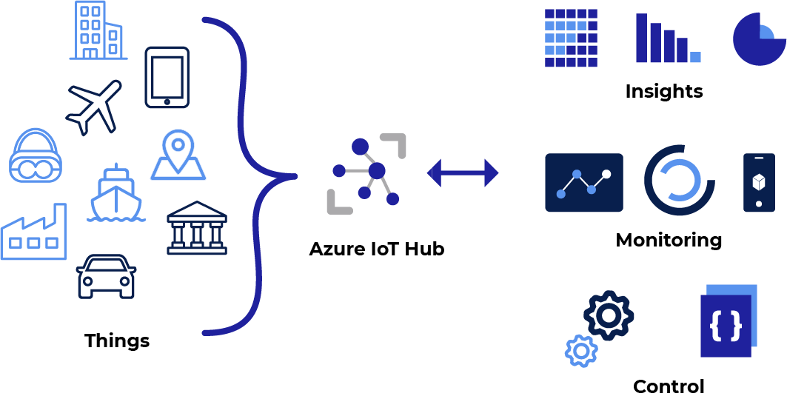
Azure IoT Hub
Central hub for managing communication between IoT devices and applications.
Facilitates data collection like temperature and humidity in real time.
Key Features:
Device provisioning
Telemetry data management
Integration with event-driven and serverless solutions

Slide 9
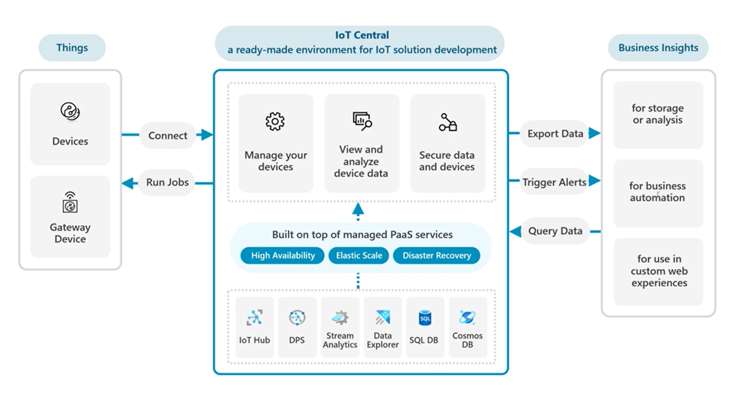
Azure IoT Central
Secure IoT application platform that scales with business needs.
Simplifies IoT solution development and management at the enterprise level.
Key Functions:
Device provisioning and visualization
Telemetry monitoring and integration with other services

Slide 10
Azure IoT Plug and Play
Connect virtually any IoT device using a mobile app.
Ideal for exploring IoT features without investing heavily in dedicated devices.
Benefits:
Telemetry data collection from smartphone sensors
Cloud-based command execution

Slide 11
Azure IoT DevKit
All-in-one development kit for creating IoT prototypes.
Compatible with Arduino and includes various sensors.
Features:
OLED display, hardware debugging, and security chip
Sample IoT projects and documentation

Slide 12
Digital Twins
Platform to create a digital representation of real-world entities.
Provides insights for better product delivery and operational optimization.
Use Cases:
Modeling buildings, factories, energy networks, etc.
Gaining insights for improved customer experiences
Image: Diagram illustrating digital twin architecture

Slide 13
IOT SECURITY
Securing IoT with Defender for IoT
Automatic discovery of unsecured assets and vulnerability detection.
Integration with Azure IoT Hub for enhanced security management.
Key Features:
Threat detection
Security posture management.
Real-time anomaly insights.
Network Analyzers in IoT Security
Role of network analyzers in monitoring traffic and detecting malicious behavior.
Assessing performance and optimizing IoT networks.
Benefits:
Identifying security threats.
Improving data transmission reliability.
Enhancing overall network resilience.

Slide 14
Azure Maps
Overview:
Collection of cloud-based mapping services.
Geospatial assistance for web and mobile applications.
SDKs for mapping data and geographic features.
Key Features of Azure Maps:
Geospatial Services: REST APIs for geocoding, routing, traffic data.
Interactive Maps: Web-based control for adding maps to applications.
Location APIs: Access to points of interest and geofencing data.
Advanced Features:
Spatial Operations: APIs for geofencing, buffering, spatial analysis.
Real-time Traffic: Access to incidents, congestion, traffic flow data.
Mobility Services: Public transit and electric vehicle charging locations.

Slide 15
Compliance and SECURITY
Compliance and Data Residency
Geographic Scope: Specify geographic area for compliance.
Data Residency: All requests stored in the specified region (EU/US).
High Availability: Data replication within geographic locations.
Authentication and Security
Authentication Mechanisms: Microsoft Entra ID, API Key, OAuth 2.0.
Security Features: TLS/SSL encryption, Network Security Groups (NSGs), Role-based Access Control (RBAC).

Slide 16
Getting Started with Azure Maps
Free Account:
Available to help developers begin.
SDKs:
Web and mobile development tools for integration.
Global Availability:
Services available in most countries/regions.
Integrations with Azure Event Grid
Event Handling: Integration with Event Grid for notifications.
Webhook Capabilities: Subscribe to events and trigger actions in real-time.

Slide 17
Development with Azure Maps
REST APIs:
Use Web SDK for Maps Search service.
Search Features:
Address geocoding, fuzzy search, reverse geocoding.
SDKs for Development
Web SDKs:
JavaScript library for web applications.
Mobile SDKs:
iOS and Android SDKs for mobile applications.
Integration:
Easy to add mapping functionality across platforms.

Slide 18
CHAPTER 9 Azure Security, Identity Management, and DevSecOps
|LEARNING MICROSOFT AZURE

Slide 19
Introduction to Cloud Security
Rise of cloud-based cyber threats
Cloud security requires a holistic approach
Defenders need to consider architecture, identities, devices, and applications
Cybersecurity and Why It Matters:
Recent cyberattacks like Ferrari’s ransomware breach
Cloud migration leads to new vulnerabilities
Key threats: data breaches, DDoS, malware, insider threats

Slide 20
Types of Cybersecurity Threats in the Cloud
Types of Cybersecurity Threats in the Cloud:
Data Breaches: Weak passwords, misconfigurations
DDoS Attacks: High-volume traffic targeting cloud services
Malware: Infected files uploaded to virtual storage
Insider Threats: Employees unintentionally causing breaches
Misconfiguration: Open access, unprotected VMs, weak identity management
API and SQL Injection Vulnerabilities:
APIs: Weak authentication and injection attacks
SQL Injection: Exploiting databases to access or alter data

Slide 21
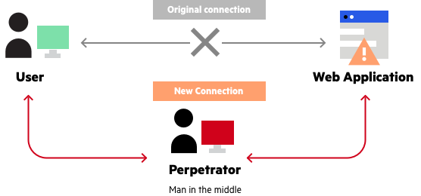
Other Common Cloud Threats
MitM Attacks: Intercepting network transmissions
Zero-Day Exploits: Attacking undiscovered vulnerabilities
Human Error in Cloud Security:
Lack of security awareness increases risks
Misconfigurations can lead to exposed data and weak identity controls
Need for security training and awareness programs

Slide 22
Preventing Cybersecurity Threats
Multi-factor authentication (MFA)
Proper identity management (Microsoft Entra ID)
Regular audits, encryption, access control

Slide 23
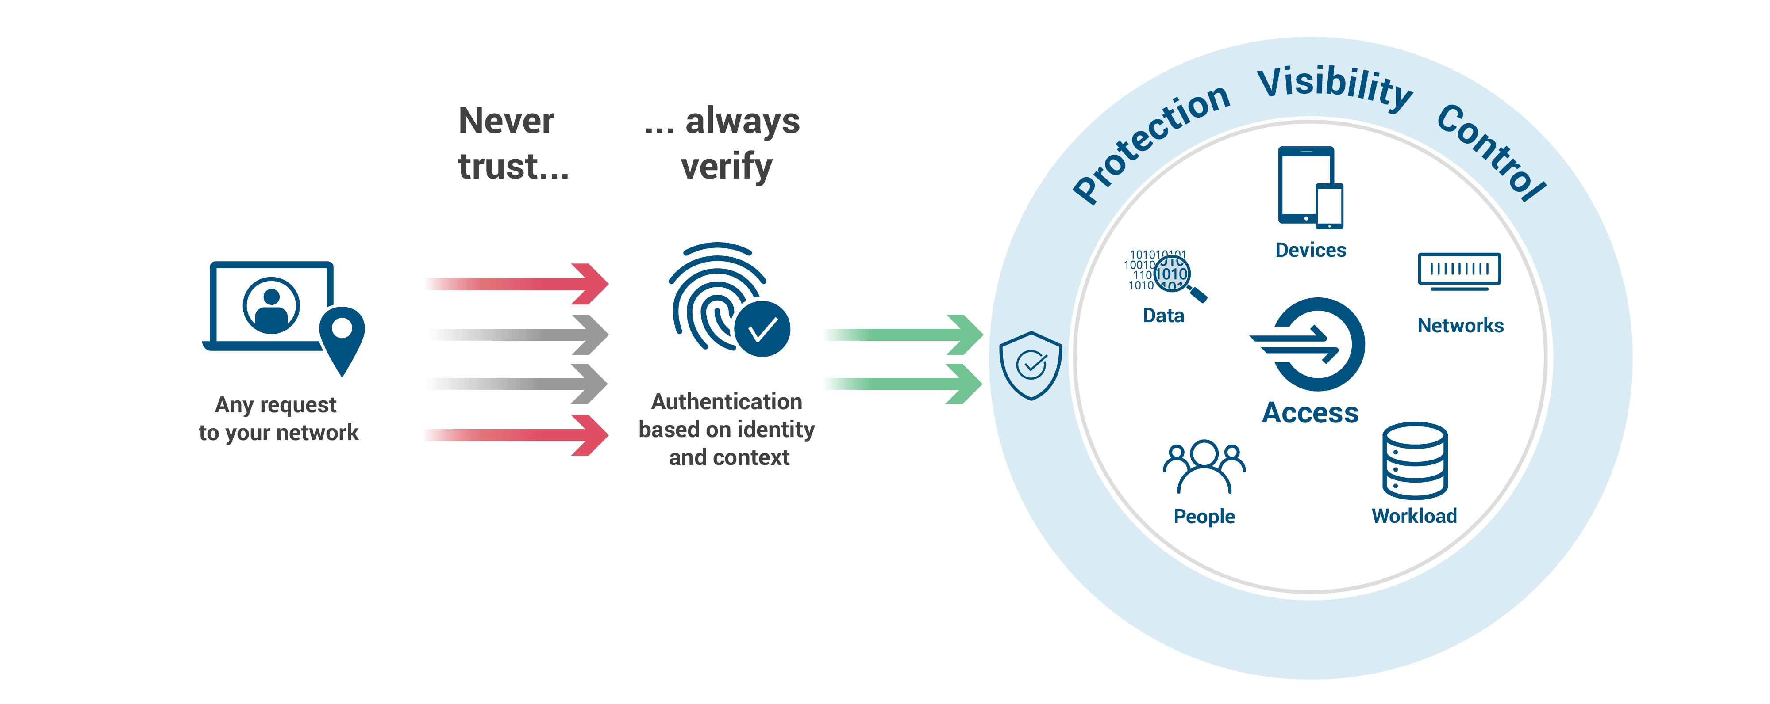
Zero Trust Methodology
Zero Trust Security in Azure:
“Never trust, always verify” principle
Strong authentication, micro-segmentation, and least privilege access
Prevent lateral movement through deep analytics and intelligence
Zero Trust: Key Components
Always Verify: Authenticate users before granting access
Least Privilege: Limit access to only what’s necessary
Micro-Segmentation: Isolate different network sections
Deep analytics for continuous monitoring
Microsoft Entra ID and Zero Trust
Microsoft Entra enables MFA, identity control, and authentication policies
Enforcing secure access across Azure resources and infrastructure
Examples of configuring policies in Azure subscriptions

Slide 24
Cloud Security Best Practices
Use Azure Security Center for monitoring
Encrypt data at rest and in transit
Implement periodic security audits and vulnerability assessments

Slide 25
DevSecOps and Security Automation
Shift-left security: integrating security into every stage of development
Automate security testing and compliance
Continuous monitoring through CI/CD pipelines
Tools for DevSecOps:
Azure DevOps: Integrated tools for automated testing and deployment
Azure Sentinel: Security information and event management (SIEM)
Azure Security Center: Monitor and protect cloud infrastructure

Slide 26
Shared Responsibility Model
Definition: Azure follows a shared responsibility model, where Microsoft and customers share security duties.
Microsoft Responsibilities:
Secures the underlying cloud infrastructure (hardware, data centers, networking).
Customer Responsibilities:
Secure applications, data, and configurations.
Ensure secure integration with third-party tools and services.

Slide 27
Increased Cybersecurity Risk Exposure
Cloud Exposure: Cloud applications are more accessible, increasing vulnerability to cyberattacks.
Portability: Cloud apps can be accessed from anywhere, creating new attack vectors.
Prevention: Tools for identifying and mitigating risks before they materialize are essential to protect cloud environments.

Slide 28
Compliance Requirements & Cloud Data Protection
Compliance Requirements
Regulatory Landscape: Industry-specific regulations (e.g., GDPR, HIPAA) require data protection and compliance.
Failure Consequences: Non-compliance can lead to fines, legal actions, and reputational damage.
Azure’s Role: Offers security benchmarks and controls to meet compliance needs.
Cloud Data Protection:
Vast Data Storage: Cloud services store large amounts of sensitive data (customer info, intellectual property).
Security Measures: Protect data storage, databases, and application communication.
Tools for Protection: Encryption, network security groups (NSGs), Azure Firewall.

Slide 29
Business Continuity in the Cloud
Definition: Business continuity ensures operations run smoothly during disruptions.
Cybersecurity Role:
Security breaches or attacks can disrupt business, so robust recovery mechanisms must be in place.
Azure Solutions:
Backup and disaster recovery tools such as Azure Site Recovery, secure backups.

Slide 30
DevSecOps
Definition: DevSecOps integrates security practices within the DevOps process.
Key Focus:
Shared accountability across development, security, and operations teams.
Early identification of security risks in the development lifecycle.
Benefits:
Enhanced collaboration and secure software development.
Deployment Strategies for DevSecOps
Canary Releases:
Small, incremental releases to a subset of users before full deployment.
Blue-Green Deployment:
Deployment of updates in separate production environments with traffic routing to validated versions.
Ring-Based Deployments:
Gradual rollout of features to larger groups of users (e.g., canaries, early adopters).

Slide 31
DevSecOps: Shift Left & Shift Right
Shift-Left in DevSecOps
Definition: Shift-left emphasizes integrating security practices early in the SDLC (design and development phases).
Key Practices: Automated testing, code reviews, security checks in the CI/CD pipeline.
Advantages: Early detection of vulnerabilities, reduced risk of security issues in production.
Shift-Right in DevSecOps
Definition: Shift-right focuses on continuous monitoring, operational security, and post-production improvements.
Key Practices: Vulnerability assessments, real-time monitoring, log analysis.
Tools: Azure Monitor, Security Center, Sentinel for threat detection and incident response.
Shifting Left vs. Shifting Right
Shift-Left:
Proactive: Prevent security issues early in the development phase.
Commonly includes unit tests and isolated environment testing (QA, staging).
Shift-Right:
Reactive: Detect and fix security vulnerabilities in production.
Uses real-world scenarios for testing durability and resilience.

Slide 32
Introduction to Azure Security
Understanding different cybersecurity threats
Importance of security in the early development phases
Overview of Azure security services for protecting workloads
Protecting data, applications, and infrastructure in the cloud
Key security areas: Identity and Access Management, Network Security, Data Security, Application Security, and Governance

Slide 33
Azure Identity and Access Management (IAM)
Azure Identity and Access Management (IAM) :
IAM controls user identities and access to resources based on roles
Differentiating between Authentication (who you are) and Authorization (what you can do)
Microsoft Entra ID for secure authentication
Use of Multi-Factor Authentication (MFA) for enhanced security
Integration with external identity providers (social identities, on-premises AD)
Authentication and Authorization in IAM:
Authentication: Verifying identity (via Microsoft Entra ID and MFA)
Authorization: Determining access levels to resources
Role-Based Access Control (RBAC) simplifies management by assigning permissions based on roles
IAM helps protect cloud resources from unauthorized access
Security auditing and compliance enabled through RBAC

Slide 34
Microsoft Entra ID
Microsoft Entra ID Features:
Manage users and access to internal/external resources (Microsoft 365, Azure Portal, SaaS apps)
Centralized IAM simplifies access management and enhances security
Identity Protection: Safeguard against identity-based attacks (phishing, credential stuffing)
Real-time risk detection and automated remediation for suspicious activities
Entra ID Risk Detection & Identity Protection:
Uses Machine Learning to detect suspicious activities (impossible travel, brute-force attacks)
Analyzes user sign-ins for risk patterns
Provides insights and recommendations for security improvements
Alerts for risky sign-ins and high-risk behaviors
Microsoft Entra Connect for Hybrid Authentication:
Hybrid identity for seamless access to on-premises and cloud-based resources
Synchronizes on-premises Active Directory with Microsoft Entra ID
Supports Single Sign-On (SSO) for internal and external apps
Hybrid identity solutions ensure consistent access control across environments

Slide 35
HYBRID IDENTITY SOLUTIONS
Password Hash Synchronization (PHS) :
Synchronizes passwords between on-premises Active Directory and Entra ID
Users only need one password for both environments
Ensures encrypted password handling (no plain-text passwords)
Enhances security through monitoring (IP lockout, leaked credential detection)
Pass-Through Authentication (PTA) :
Authenticate users directly against on-premises Active Directory
Avoids storing passwords in the cloud
Enhances user experience by reducing the need to remember multiple passwords
All network traffic is encrypted for secure authentication
Active Directory Federation Services (AD FS):
Provides advanced authentication for hybrid identity solutions
Supports SSO across organizational boundaries
AD FS handles authentication tasks for Microsoft Entra ID
Migrating from AD FS to Microsoft Entra ID is recommended for enhanced security

Slide 36
Role-Based Access Control (RBAC)
Granular control over who can access resources in Azure
Over 120 predefined roles (e.g., Owner, Contributor, Reader)
Custom roles can be created for specific business needs
Access can be granted/denied at subscription, resource group, or individual resource levels

Slide 37
Multi-Factor Authentication
Adds additional layers of security beyond just passwords
Supported methods: SMS codes, biometric authentication, FIDO security keys
Required for high-risk activities and critical access
Microsoft Entra MFA supports a wide range of authentication mechanisms

Slide 38
Introduction to Managed Identities
Simplifies credential management for Azure-deployed applications
Eliminates the need for developers to manage certificates or keys

Slide 39
Managed Identities - Types
System-Assigned Managed Identities:
Automatically created and linked to an Azure resource
Deleted when the resource is deleted
Useful for single resource-bound identities
User-Assigned Managed Identities:
Created independently of resources
Can be assigned to multiple resources
More flexible, reusable across different services and subscriptions

Slide 40
Managed Identities
Benefits of Managed Identities:
Improved security by removing credential management
No need for maintaining or rotating secrets
Simplifies access control to Azure services and resources
Use Cases for Managed Identities:
Authentication to Azure services (e.g., Key Vault, Storage Accounts, SQL Database)
Virtual machine access control
Secure service connections for CI/CD pipelines
Security Improvements with Managed Identities:
Reduces risk of security breaches
Simplifies credential management processes
Aligns with security best practices by eliminating hard-coded secrets

Slide 41
Managed Identities in Azure DevOps
Managed Identities for Azure DevOps:
Can be used for CI/CD pipeline service connections
Eliminate the need for Personal Access Tokens (PATs) or frequent token renewal
Integration with Workload Identity Federation for automated token management
Managed Identities vs Service Principals:
Managed Identities: Automated lifecycle, no secret management
Service Principals: Used for custom applications and require key/secret management
Service Principal Roles and Permissions:
Authenticate resources to Azure services (e.g., Microsoft Graph API)
Grant roles and permissions for specific access control scenarios
Often used in manual app registrations and enterprise applications

Slide 42
Azure Key Vault Integration
Seamless integration for accessing secrets and certificates
Enhances application security by avoiding manual secret handling
Recommended for SSL/TLS certificates and client secrets management

Slide 43
Azure Network Security
Overview:
Azure Network Security protects Azure infrastructure and applications through a range of features.
It isolates resources, secures network environments, and defends against threats.
Key services include:
Network Security Groups (NSGs)
Azure Firewall
Azure DDoS Protection
Azure Bastion

Slide 44
Network Security Groups (NSGs)
What are NSGs?
Filters network traffic at the network interface or subnet level.
Controls traffic based on:
Source and destination IPs
Port numbers
Protocol (TCP/UDP)
Use Cases:
Implement rules to allow or block inbound/outbound traffic to resources like VMs and databases.

Slide 45
Additional Azure Network Security Features
Azure Firewall:
A managed service that provides:
L3 to L7 filtering
Protection against malicious traffic.
Azure DDoS Protection:
Automatic detection and mitigation of DDoS attacks.
Azure Bastion:
Securely connects to VMs using RDP and SSH directly from the Azure Portal without exposing public IPs.

Slide 46
Secure Coding Practices in Azure Applications
Overview:
Secure Coding: Essential for protecting Azure apps from data breaches, malware, and denial-of-service attacks.
Critical Practices:
Input Validation
Security Scanning
Secure Communication
Error Handling
Importance:
Ensures compliance with standards like HIPAA and PCI DSS.
Reduces vulnerabilities, leading to more secure applications.

Slide 47
Application Data Input Validation & Security Scanning
Application Data Input Validation:
Validate data types, lengths, and formats to prevent SQL Injection and XSS.
Example: Ensure user inputs in Azure applications are secure and sanitized.
Security Scanning & Checks in CI/CD Pipelines:
Implement authentication and authorization with MFA and RBAC using Microsoft Entra ID.
Store sensitive data (API keys, tokens) securely in Azure Key Vault.
Integrate security scanning tools in CI/CD pipelines for continuous monitoring and protection.

Slide 48
Secure Communication, Error Handling & DevSecOps
Secure Communication:
Use HTTPS for all data transmission to prevent interception and data leaks.
Encrypt communication between Azure apps and other services to protect data in transit.
Error Handling:
Implement error-handling mechanisms that avoid exposing sensitive information in logs or messages.
Example: Ensure error messages do not reveal application or system details that attackers could exploit.
DevSecOps:
Integration of security practices into the DevOps lifecycle.
Focus on shift-left security: embedding security from the start of development.
Key Practices in DevSecOps:
Automation: Automate security scans in CI/CD with tools like Azure Security Center, Microsoft Defender, and Azure Policy.
Continuous Testing & Monitoring: Perform security tests throughout development and after deployment.
Infrastructure as Code (IaC): Use tools like ARM templates, Bicep, and Terraform for secure infrastructure deployment.

